Slide 1
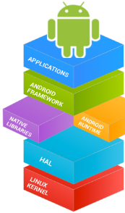

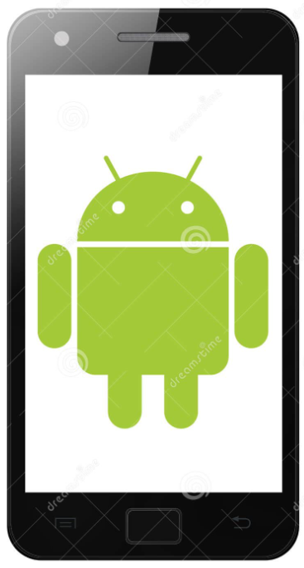
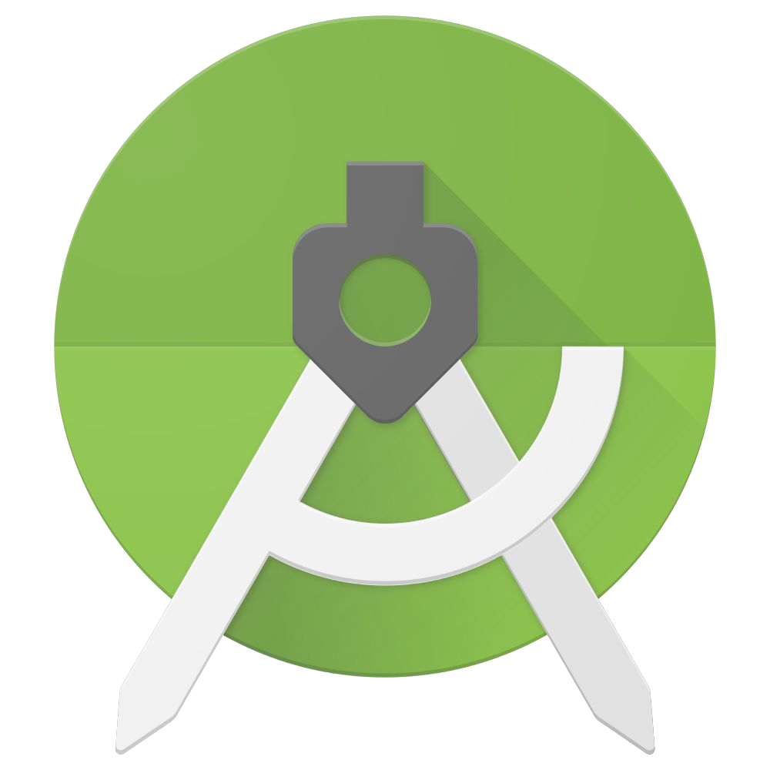
Mobile Application Development (COS7025-B) Introduction to Android Software Stack
Karim Hammoud Sadik
Lecture #2
Android Studio

Slide 2
Contents
This week's lecture will cover an overview of the mobile application types, advantages and disadvantages, and an introduction to the Android software stack.
The lab activity will focus on the installation of Android studio on your personal devices, and walk through the studio environment.

Slide 3
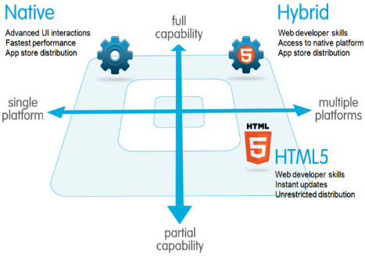
Mobile Application Types
Native
-Native apps are specific to a given mobile platform (iOS or Android) using the development tools and language that the respective platform supports (e.g., Xcode and Objective-C/Swift with iOS, Android Studio with Android).
-They are developed specifically for one platform, and can take full advantage of all the device features

Slide 4
Mobile Application Types : Native
There are some things you get with native apps (advantages):
Multi touch - double taps, pinch-spread, and other compound UI gestures
Fast graphics API & Fluid Animation- the native platform gives you the fastest graphics, and fast refresh for using a lot of data and require a fast refresh. This is especially important in gaming, highly interactive reporting, or intensely computational algorithms for transforming photos and sounds.
Built-in components - The camera, address book, geolocation, and other features native to the device can be seamlessly integrated into mobile apps.
Ease of use - The native platform is what people are familiar to, and so when you add that familiarity with all of the native features they expect, you have an app that’s just plain easier to use (example - app bar and back button)
Documentation – it generally has better documentation.
Subjective view on the potential pitfalls of native apps:
Native apps are more difficult to develop. Likewise, the level of experience required is higher than other development scenarios.
Longer development and testing cycles, after which the consumer typically must log into a store and download a new version to get the latest fix.
Industry advice: When going native, you’ll have to map out a cross-platform strategy. Consider which of the platforms you’ll target and the order in which you’ll publish them.

Slide 5
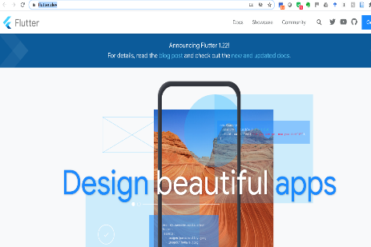
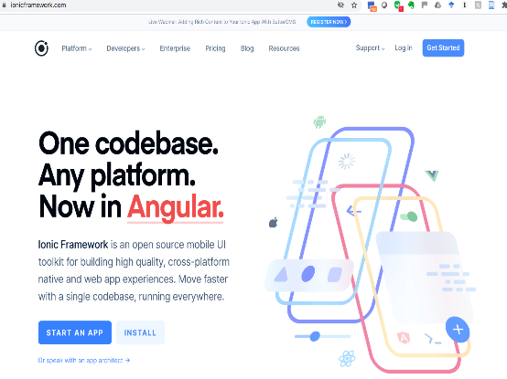
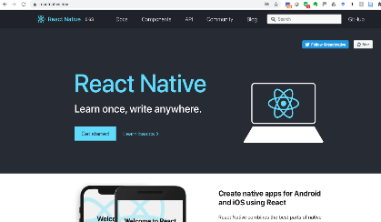
Native Mobile Application Framework

Slide 6

Mobile Application Types
Hybrid
Hybrid apps make it possible to embed HTML5 apps inside a thin native container, combining the best (and worst) elements of native and HTML5 apps
Flutter, React and Ionic are examples popular container for creating hybrid mobile apps. Few others: Intel XDK, Phonegap

Slide 7
Mobile Application Types : Hybrid
Main Advantage:
Existing web developers that have become gurus at optimizing JavaScript, pushing CSS to create beautiful layouts, and writing compliant HTML code that works on any platform can now create sophisticated mobile applications that don’t sacrifice the cool native capabilities.
Code base is re-usable between mobile platforms
Should result in lower development costs
Disadvantages:
native mobile apps provide a better user experience; hybrid apps do not always look or feel as smooth and natural
they can be slow! Can you guess why?

Slide 8

Mobile Application Types : Web Apps
Websites that are developed using responsive website design to work with mobile devices (e.g. HTML5, bootstrap UI)
An HTML5 mobile app is basically a web page, or series of web pages, that are designed to work on a tiny screen.
As such, HTML5 apps are device unsure and can be opened with any modern mobile browser. ("write-once-run-anywhere“)
Potential advantages are: Familiarity of technologies; ease of development; distribution and support is much easier than for native apps;
Downside: Every device have their own idea of what is ideal screen size; offline security and storage is complex compared to native apps; graphics and user interaction is not comparable to native; native functions such as camera, storage, accelerometer, gestures not available;

Slide 9
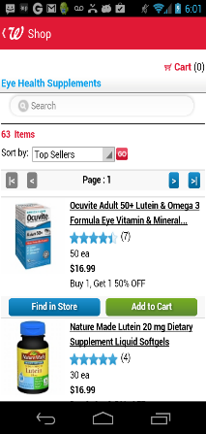
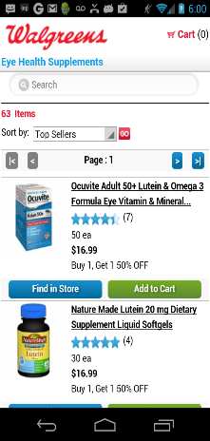
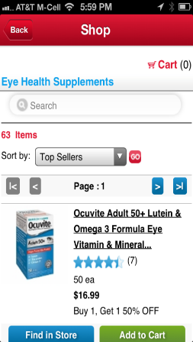
Examples
Web App
Android
iOS
m.walgreens.com

Slide 10
Industrial viewpoints
“The biggest mistake we’ve made as a company is betting on HTML5 over native”, said Mark Zuckerberg at the TechCrunch Disrupt conference in San Francisco. He also stated about going completely native, “…we just couldn’t bet completely on it”. Mark Zuckerberg, Facebook
See here: http://techcrunch.com/2012/09/11/mark-zuckerberg-our-biggest-mistake-with-mobile-was-betting-too-much-on-html5/
Mobile development is a constantly moving target. Every six months, there’s a new mobile operating system, with unique features only accessible with native APIs. The containers bring those to hybrid apps soon thereafter, with the web making tremendous leaps every few years. (salesforce)
“It would be nice to declare a winner here, but right now, there is no clear winner. Some apps are best suited for native and some are best suited for the web. …..hybrid apps, …may be the best compromise for some developers: web view where it's possible and platform-specific native components where it's not.” Michael Mahemoff
Regardless of whether you’re going to build a native or hybrid app, you should have a mobile version of your Web site. Mobile Web sites offer the largest immediate and instant reach of all the types of apps.
(Rachel Appel, in Microsoft MSDN blog)

Slide 11
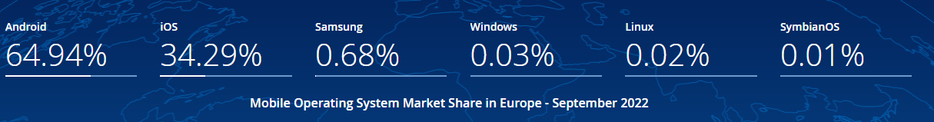
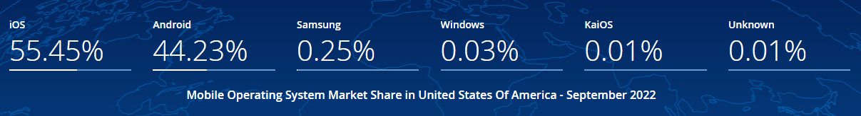
Q: Which are the Top 3 Mobile Operating Systems*? *as per worldwide market share
Source: IDC (https://gs.statcounter.com)

Slide 12
Discussion: Success of Android

Slide 13
Android – in numbers
A Software Stack (OS) based on Linux Kernel; Google-led development
Largest Install base - Powers hundred of millions of mobile devices in more than 190 countries around the world.
Largest number of Apps/Download – Over 1 Million apps & 50 Billion Downloads (July 2013) [1]
The largest installed base of any mobile platform and growing fast
Android’s openness has made it a favourite for consumers and developers alike, driving strong growth in app consumption.
[1] http://www.phonearena.com/news/Androids-Google-Play-beats-App-Store-with-over-1-million-apps-now-officially-largest_id45680

Slide 14
History of Android
Android was originated by a group of companies known as the Open Handset Alliance, led by Google.
Today, many companies -- both original members of the OHA and others -- have invested heavily in Android. These companies have allocated significant engineering resources to improve Android and bring Android devices to market.
More Details at :
https://source.android.com/source/index.html
https://source.android.com/docs/setup

Slide 15
Operating Systems
Different OS run on different types of hardware and are designed for different types of applications. For example, iOS is designed for iPhones and iPad tablets, while Mac desktops and laptops use macOS.
Microsoft Windows :
Initial versions of Windows worked with MS-DOS, providing a modern graphical interface on top of DOS's traditional text-based commands. The Windows Start menu helps users find programs and files on their devices.
APPLE IOS
Apple's iOS is one of the most popular smartphone operating systems, second only to Android. It runs on Apple hardware, including iPhones, iPad tablets and iPod Touch media players.
GOOGLE'S ANDROID OS
Android is the most popular operating system in the world judging by the number of devices installed. Users can download custom versions of the operating system.
APPLE MAC OS
Apple's macOS, successor to the popular OS X operating system, runs on Apple laptops and desktops.. MacOS is known for its user-friendly features, which include Siri and FaceTime.
LINUX OPERATING SYSTEM
Linux can be run on a wide variety of hardware and is available free of charge over the internet

Slide 16
Feature of Android
Android is a powerful operating system competing with Apple 5GS and support great features. Few of them are listed below:
Feature | Description
Beautiful UI | Android OS basic screen provides a beautiful and intuitive user interface.
Connectivity | GSM/EDGE, IDEN, CDMA, EV-DO, UMTS, Bluetooth, Wi-Fi, LTE, NFC and WiMAX.
Storage | SQLite, a lightweight relational database, is used for data storage purposes.
Media support | H.263, H.264, MPEG-4 SP, AMR, AMR-WB, AAC, HE-AAC, AAC 5.1, MP3, MIDI, Ogg Vorbis, WAV, JPEG, PNG, GIF, and BMP
Messaging | SMS and MMS
Web browser | Based on the open-source WebKit layout engine, coupled with Chrome's V8 JavaScript engine supporting HTML5 and CSS3.

Slide 17
Feature of Android
Android is a powerful operating system competing with Apple 5GS and support great features. Few of them are listed below:
Feature | Description
Multi-touch | Android has native support for multi-touch which was initially made available in handsets such as the HTC Hero.
Multi-tasking | User can jump from one task to another and same time various application can run simultaneously.
Resizable widgets | Widgets are resizable, so users can expand them to show more content or shrink them to save space
Multi-Language | Support single direction and bi-directional text.

Slide 18
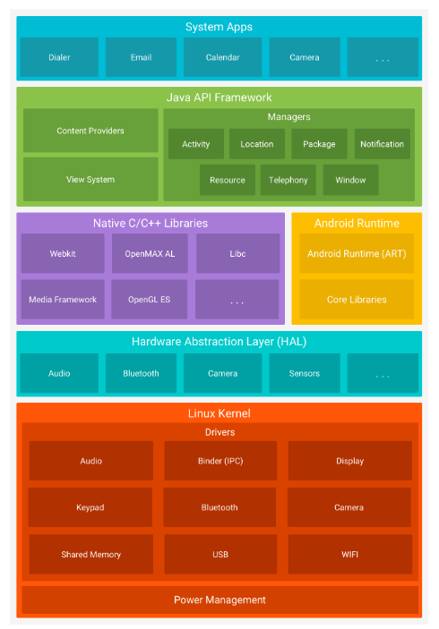
Android Software Stack
A software stack for mobile devices:
Operating system, middleware
& key applications
Source: https://developer.android.com/guide/platform
Aim of Android: production-quality consumer product with source code open for customisation

Slide 19
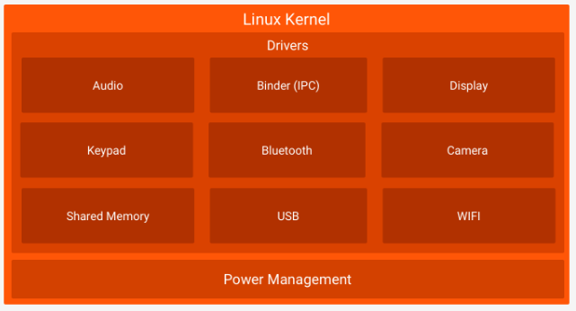

Linux Kernel
Linux Kernel
Foundation of Android OS
Effective power management
Effective device drivers and management
Communication: Bluetooth, Wifi
USB, Display, Camera
Much more

Slide 20
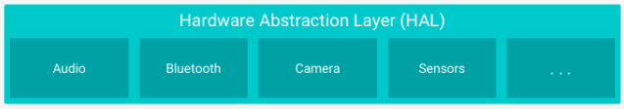
Hardware Abstraction Layer (HAL)
Abstraction layer between HW & SW
Provides services such as:
Standard interface for HW capabilities to the Java API framework
Multiple library modules for each HW – Camera, BT, Sensors, etc

Slide 21
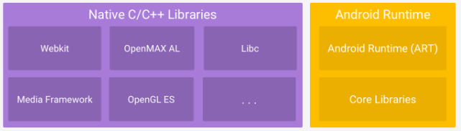
Android Runtime and Native Libraries
Native C/C++Libraries:
Many features needs core Libs
Also provide java framework
Webkit, MediaFramework, etc
OpenGL
SQLite
Android Runtime:
Each app run its process and instance of ART (Ver 5.0) and higher
Art run multiple VM on low memory
More features mostly on optimising apps

Slide 22
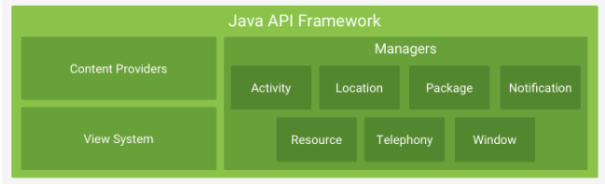
Android Java API Framework
Android Java API Framework:
Provides entire feature set to us through APIs written in Java. The APIs are building blocks for creating apps. Features include:
Extensible View Systems – UI, list, grids, textboxes, buttons, etc
Resource manager: access to code resource e.g graphics
Notification Manager
Activity manager

Slide 23
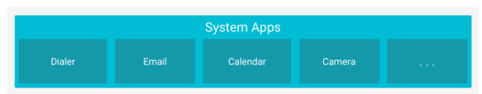
Android System Apps
Android System Apps:
Apps that Android comes built in with include:
Telephony dialer
Email
Calendar
More ..

Slide 24
Mobile App Development

Slide 25
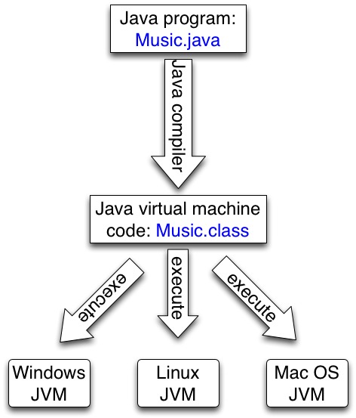
Q:Java Compiler and Virtual Machine (platform independent + portable)
The Java Compiler
Reads file with extension .java
Checks syntax / grammar
Creates a .class file which contains byte code (machine code) independent of any machine
Java Byte Code
Is portable
The JVM(Java Virtual Machine)
Translates byte code in to instructions for a particular processor, which “runs the program”

Slide 26
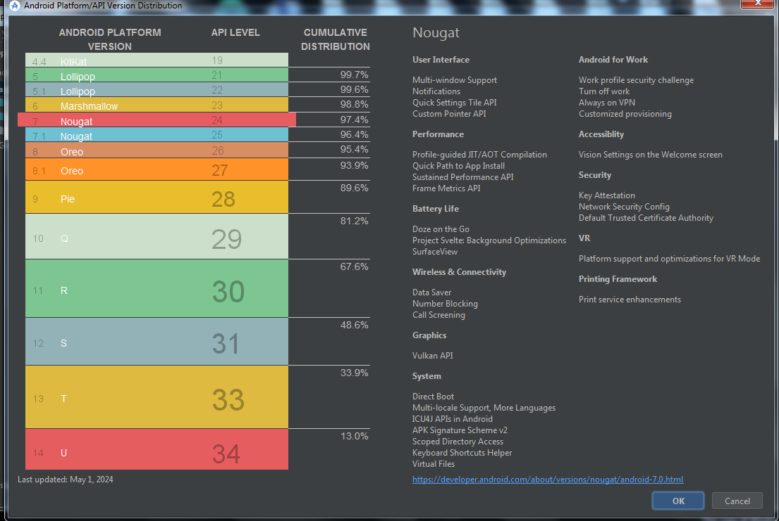
Android Versions
Android History and Platform Versions

Slide 27
What is Android Mobile App?
● One or more screens that are interactive
● Using Java Programming and XML
● Using the Android Software Development Kit (SDK)
Development tools (debugger, monitors, editors)
Libraries (maps, wearables)
Virtual devices (emulators)
Documentation (developer.android.com)
Sample code
● Using Android libraries and Android Application Framework
View class hierarchy to create UI screens
Notification manager
Activity manager for life cycles and navigation
● Executing by Android Runtime Virtual machine (ART)
Each app runs in its own process with its own instance of the Android Runtime.

Slide 28
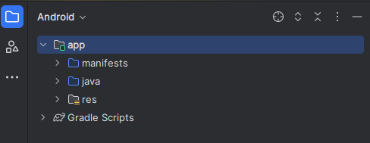
Building Block for Android Mobile App
Manifest: information about app for the runtime
Components: activities, services, and helper classes as Java code
Resources: layouts, images, strings, colours as XML and media files
Build configuration: APK versions in Gradle config files

Slide 29
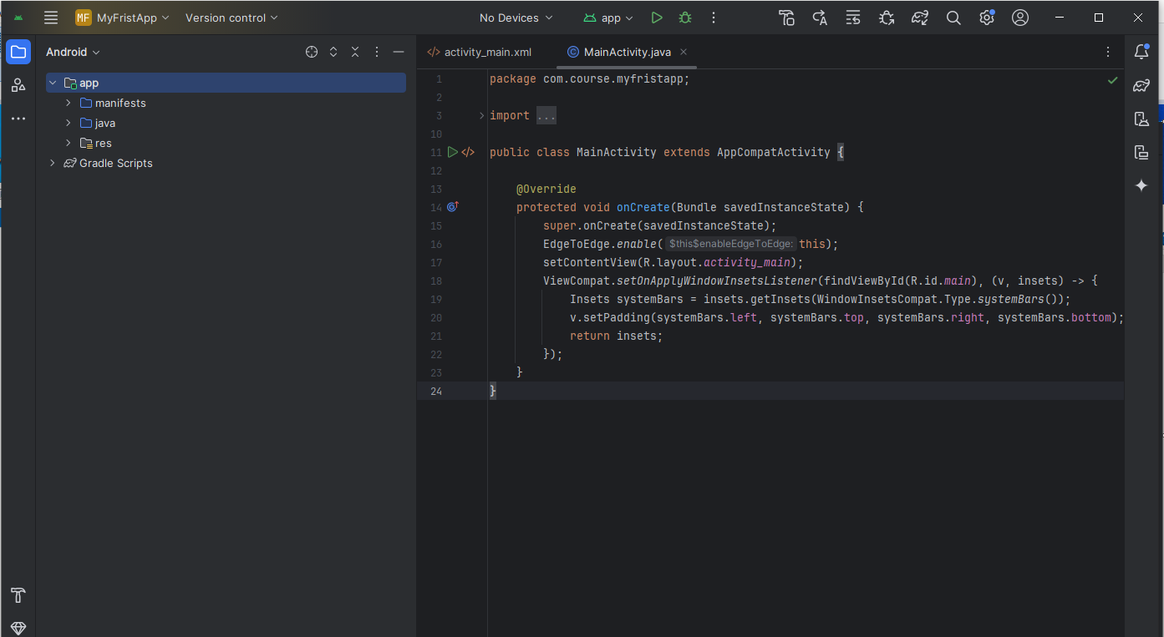
What is Android Studio?
Building your first Android Mobile app using Android Studio
Android Integrated Development Environment (IDE)
Project and Activity templates
Layout editor
Testing tools
Gradle-based build
Log console and debugger
Emulators

Slide 30
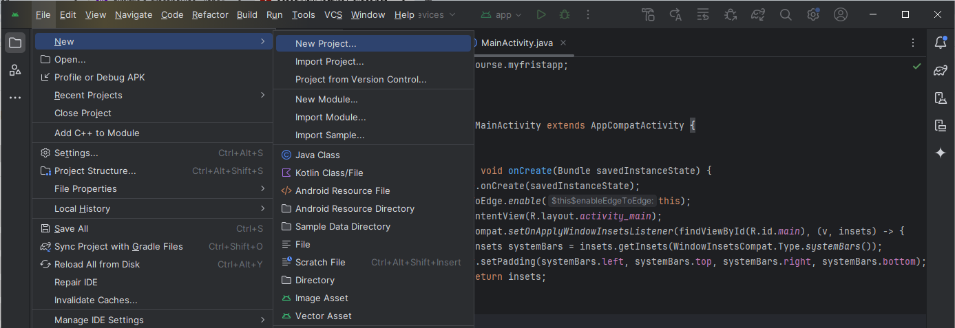
Creating a new project inside Android Studio

Slide 31
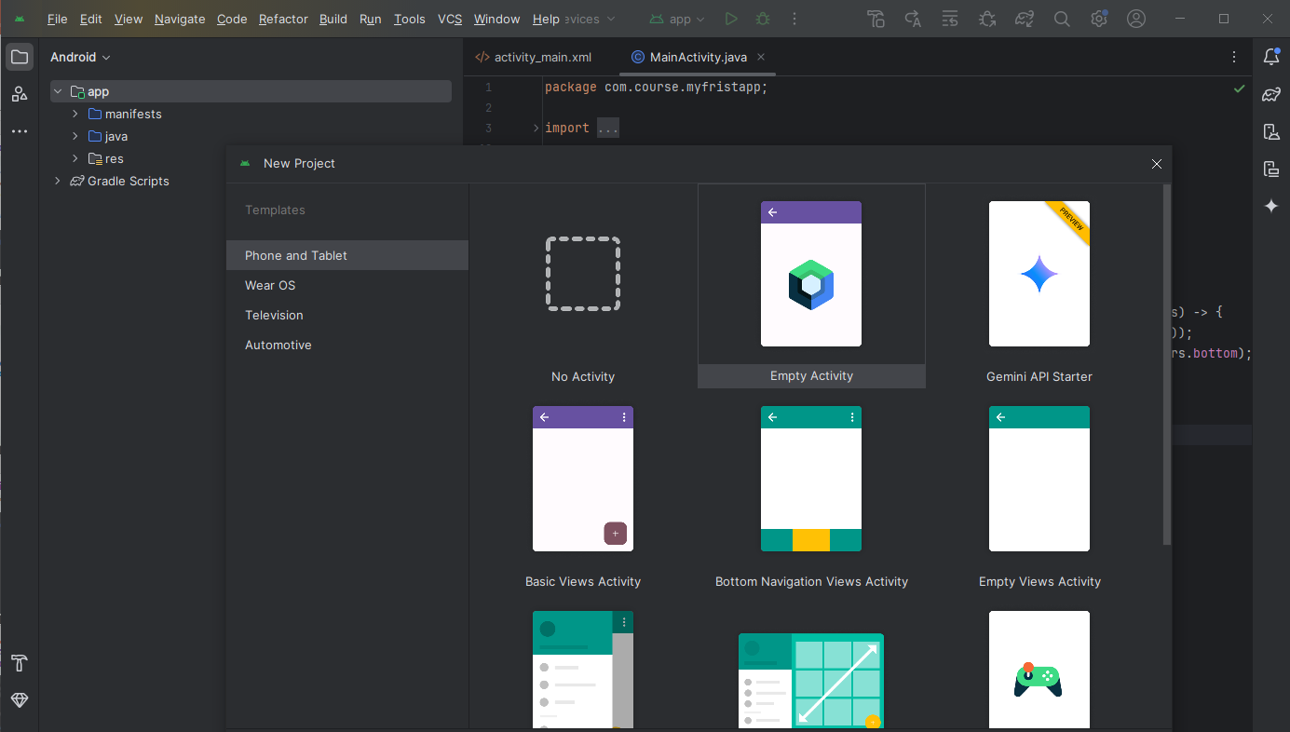
Select activity template
Select templates for common activities, such as maps or navigation drawers. Pick Empty View Activity for simple activities.

Slide 32
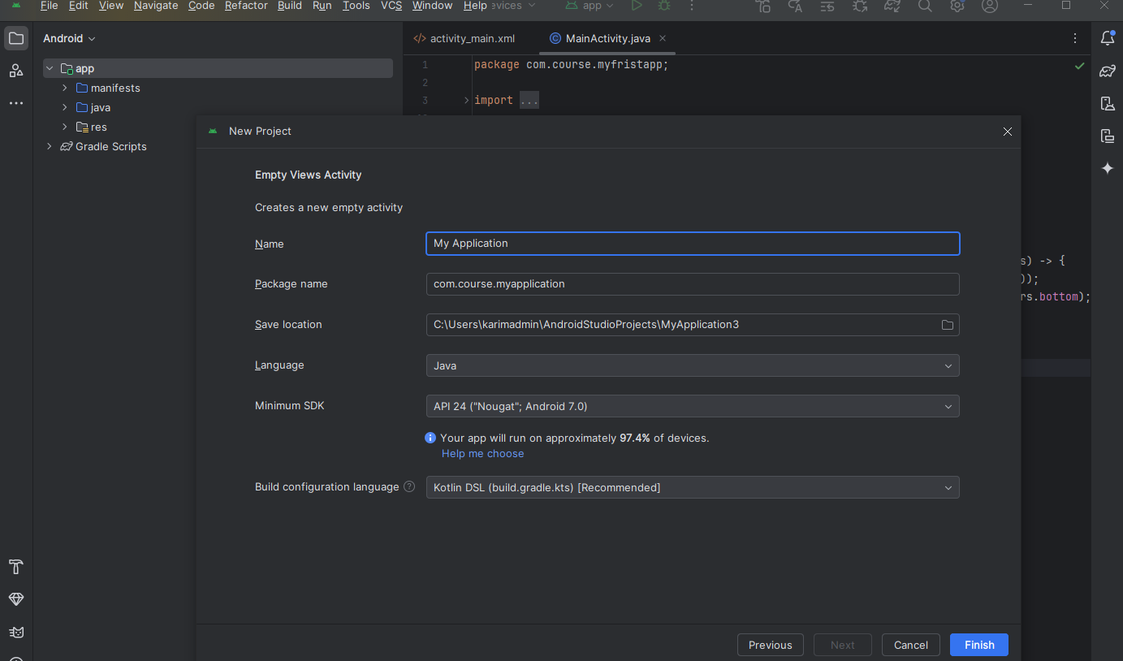
Name your Mobile App

Slide 33
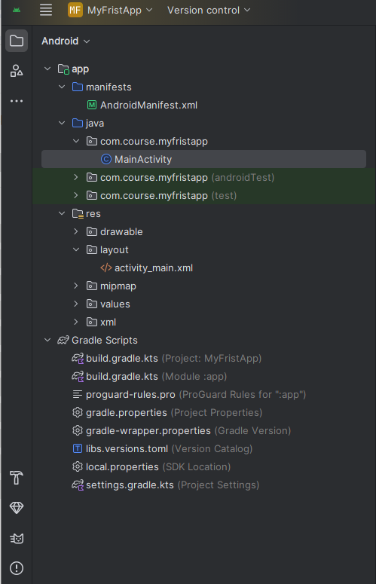
Android Project Folder
manifests—Android Manifest file - description of app read by the Android runtime
java—Java source code packages
res—Resources (XML) - layout, strings, images, dimensions, colors...
build.gradle—Gradle build files
Three build.gradle:
○ project
○ module
○ settings
Learn more about gradle at https://gradle.org/

Slide 34
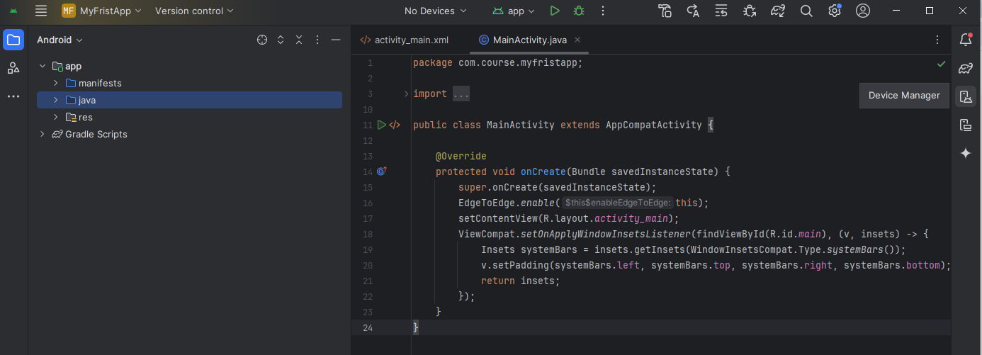
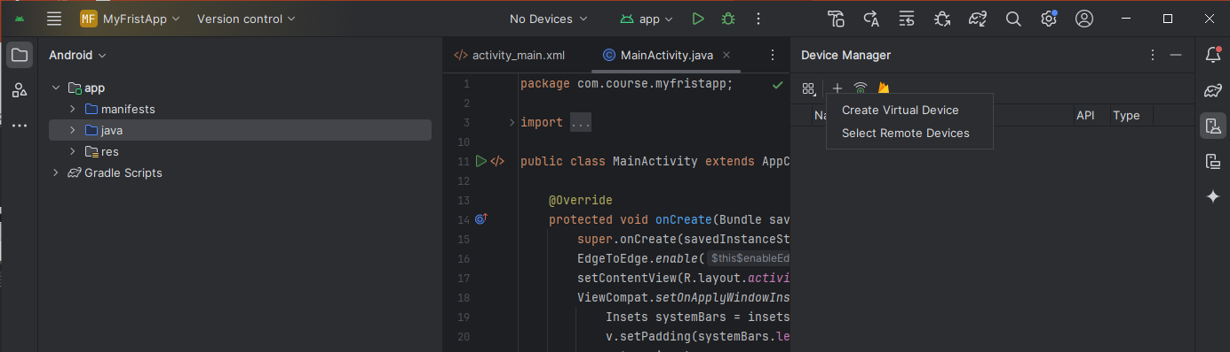
Run your Mobile App
Click on Device Manager
Click on virtual device

Slide 35
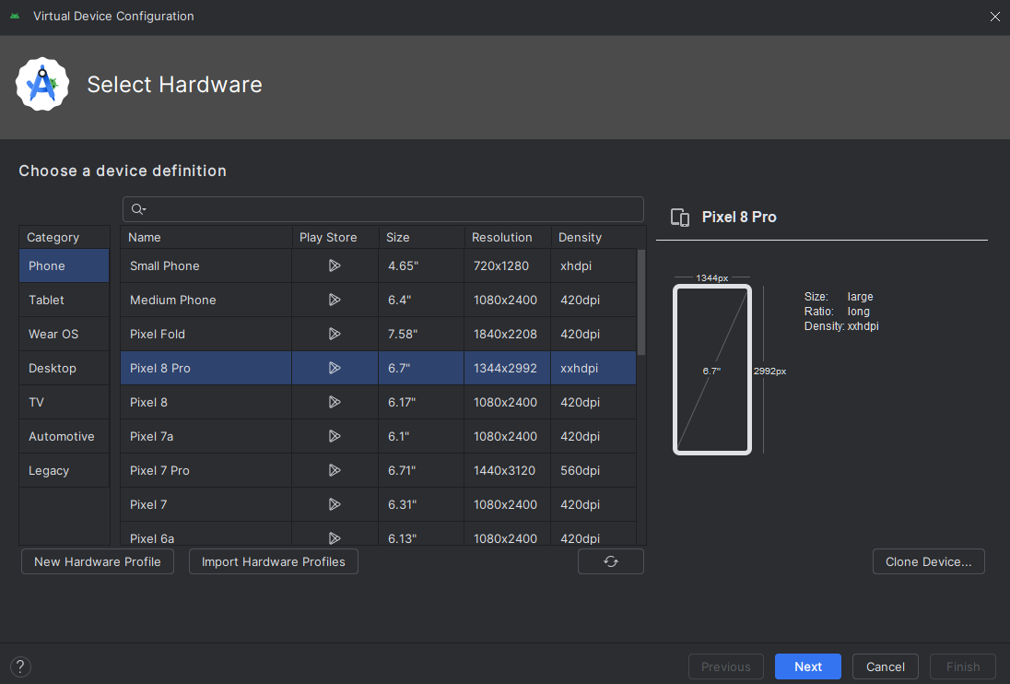
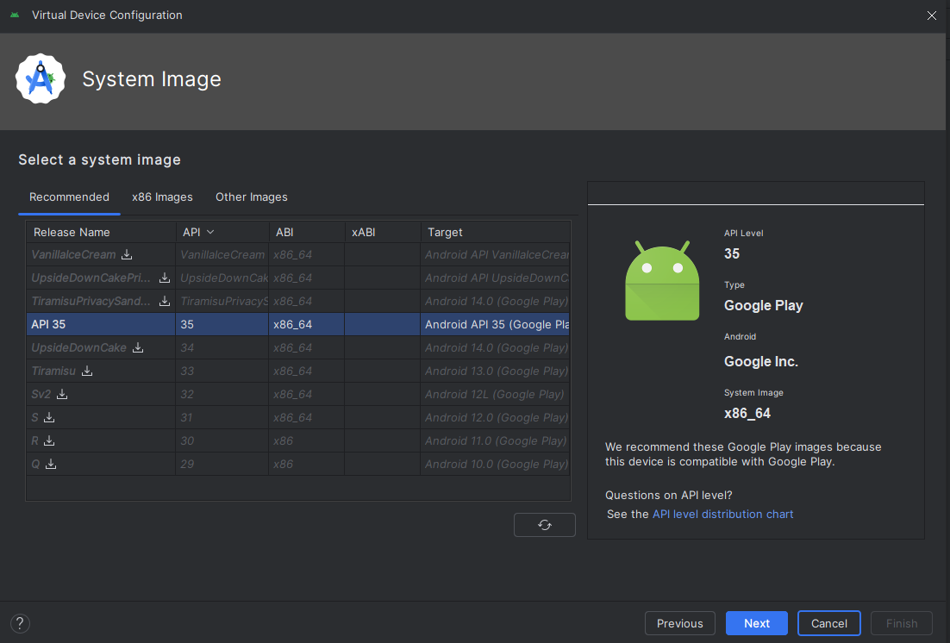
Create and configure virtual device
Use emulators to test app on different versions of Android and form factors.
Choose hardware
Select Android version
Select System Image
Finalize

Slide 36
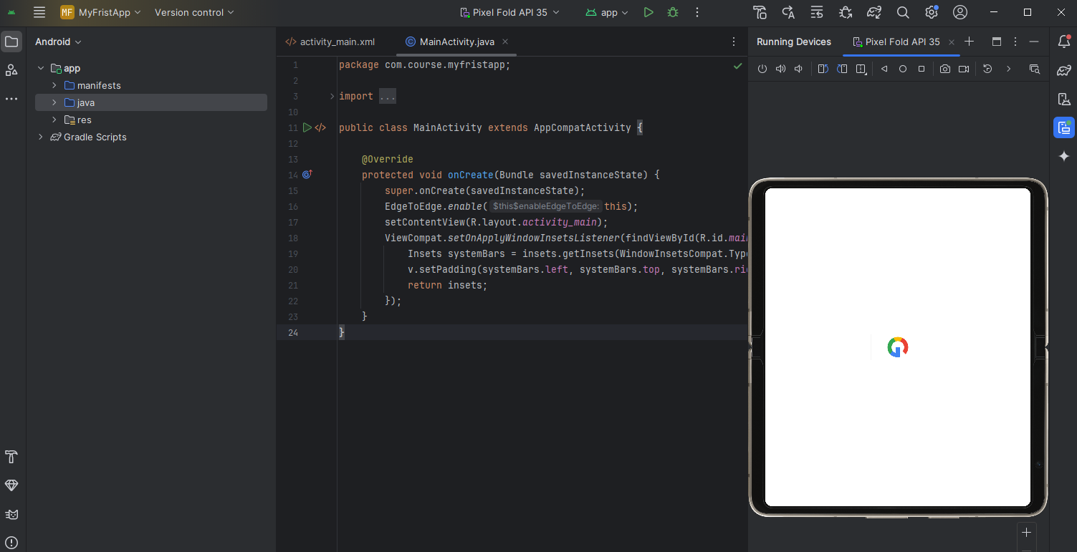
Run on a virtual device

Slide 37
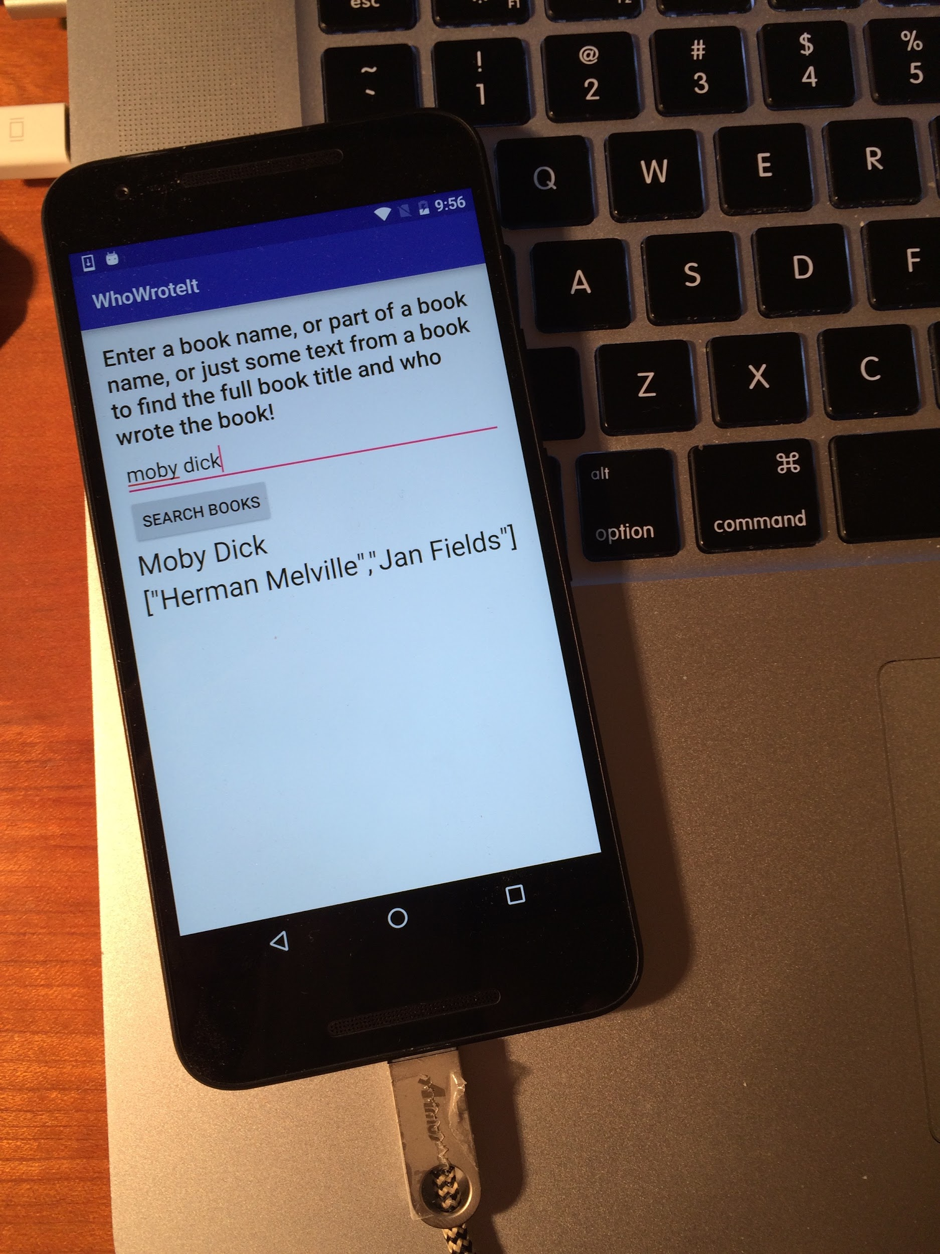
Run on a physical device
Turn on Developer Options:
Settings > About phone
Tap Build number seven times
Turn on USB Debugging
Settings > Developer Options > USB Debugging
Connect phone to computer with cable

Slide 38
Getting feedback as your app runs
Adding logging to your app
When the Mobile app runs, the Logcat pane displays information
Add logging statements to your Mobile app that will show up in the Logcat pane
Set filters in Logcat pane to see what's important to you
Search using tags
Add Logging java statement to MainActivity Class
import android.util.Log;
// Use class name as tag
private static final String TAG = MainActivity.class.getSimpleName();
// Show message in Android Monitor, logcat pane
// Log.<log-level>(TAG, "Message");
Log.d(TAG, “Creating the URI…”);

Slide 39
Learn more
Meet Android Studio
Official Android documentation at developer.android.com
Create and Manage Virtual Devices
Supporting Different Platform Versions
Supporting Multiple Screens

Slide 40
Learn even more
Gradle Wikipedia page
Google Java Programming Language style guide
Find answers at Stackoverflow.com

Slide 41
Any Questions?

